Slide 1

Data Structures Using C++ 2E
Chapter 11
Binary Trees and B-Trees

Slide 2
Objectives
Learn about binary trees
Explore various binary tree traversal algorithms
Learn how to organize data in a binary search tree
Discover how to insert and delete items in a binary search tree
Data Structures Using C++ 2E

Slide 3
Objectives (cont’d.)
Explore nonrecursive binary tree traversal algorithms
Learn about AVL (height-balanced) trees
Learn about B-trees
Data Structures Using C++ 2E

Slide 4
Binary Trees
Definition: a binary tree, T, is either empty or such that
  T has a special node called the root node
  T has two sets of nodes, L_{T} and R_{T}, called the left subtree and right subtree of T, respectively
  L_{T} and R_{T} are binary trees
Can be shown pictorially
  Parent, left child, right child
Node represented as a circle
  Circle labeled by the node
Data Structures Using C++ 2E

Slide 5
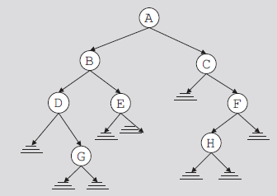
Binary Trees (cont’d.)
Root node drawn at the top
  Left child of the root node (if any)
    Drawn below and to the left of the root node
  Right child of the root node (if any)
    Drawn below and to the right of the root node
Directed edge (directed branch): arrow
FIGURE 11-1 Binary tree
Data Structures Using C++ 2E

Slide 6
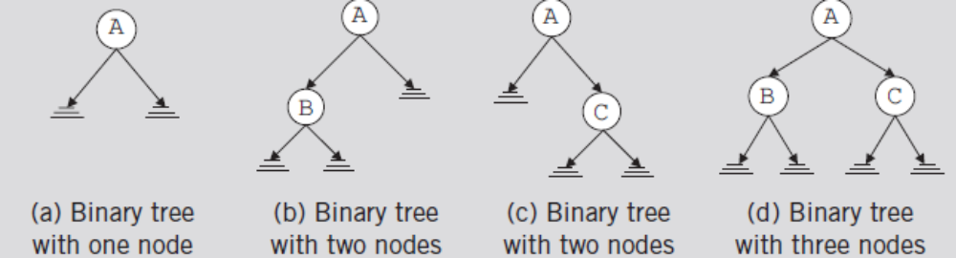
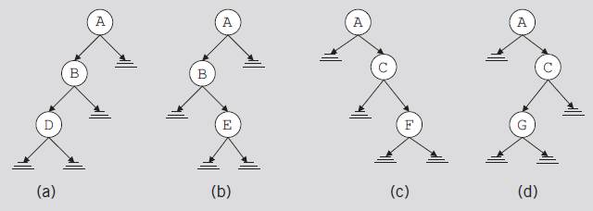
Binary Trees (cont’d.)
FIGURE 11-2 Binary tree with one, two, or three nodes
FIGURE 11-3 Various binary trees with three nodes
Data Structures Using C++ 2E

Slide 7
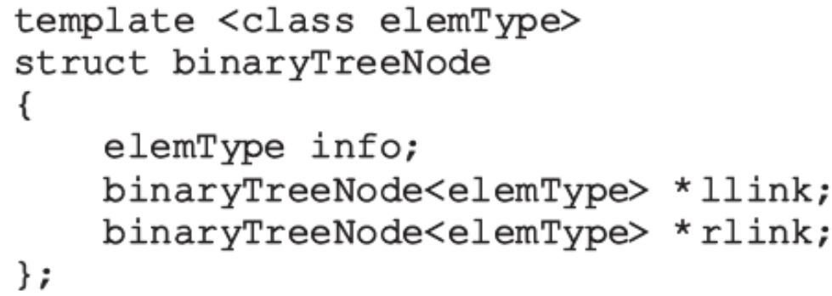
Binary Trees (cont’d.)
Every node in a binary tree
  Has at most two children
struct defining node of a binary tree
  For each node
    The data stored in info
    A pointer to the left child stored in llink
    A pointer to the right child stored in rlink
Data Structures Using C++ 2E

Slide 8
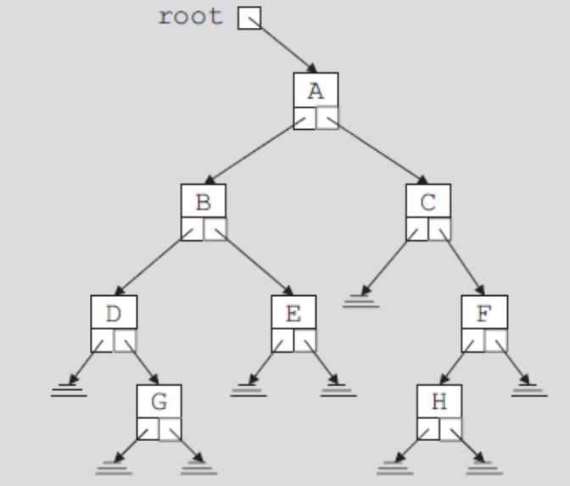
Binary Trees (cont’d.)
Pointer to root node is stored outside the binary tree
  In pointer variable called the root
    Of type binaryTreeNode
FIGURE 11-4 Binary tree
Data Structures Using C++ 2E

Slide 9
Binary Trees (cont’d.)
Level of a node
  Number of branches on the path
Height of a binary tree
  Number of nodes on the longest path from the root to a leaf
  See code on page 604
Data Structures Using C++ 2E

Slide 10
Copy Tree
Shallow copy of the data
  Obtained when value of the pointer of the root node used to make a copy of a binary tree
Identical copy of a binary tree
  Need to create as many nodes as there are in the binary tree to be copied
  Nodes must appear in the same order as in the original binary tree
Function copyTree
  Makes a copy of a given binary tree
  See code on pages 604-605
Data Structures Using C++ 2E

Slide 11
Binary Tree Traversal
Must start with the root, and then
  Visit the node first or
  Visit the subtrees first
Three different traversals
  Inorder
  Preorder
  Postorder
Data Structures Using C++ 2E

Slide 12
Binary Tree Traversal (cont’d.)
Inorder traversal
  Traverse the left subtree
  Visit the node
  Traverse the right subtree
Preorder traversal
  Visit the node
  Traverse the left subtree
  Traverse the right subtree
Data Structures Using C++ 2E

Slide 13
Binary Tree Traversal (cont’d.)
Postorder traversal
  Traverse the left subtree
  Traverse the right subtree
  Visit the node
Each traversal algorithm: recursive
Listing of nodes
  Inorder sequence
  Preorder sequence
  Postorder sequence
Data Structures Using C++ 2E

Slide 14
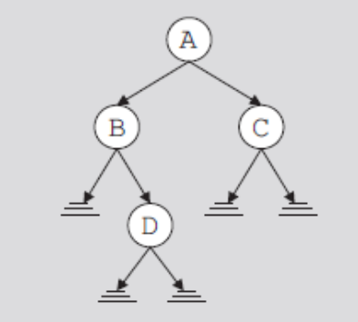
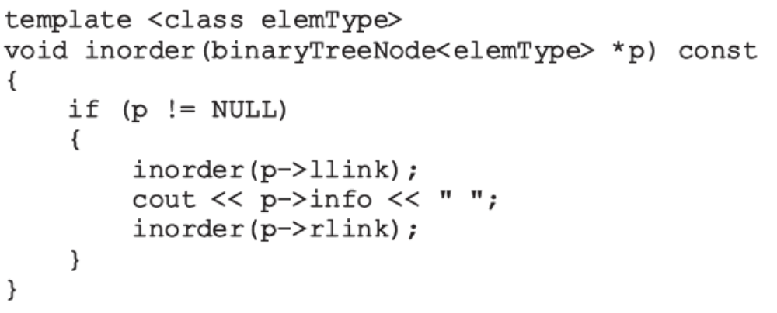
Binary Tree Traversal (cont’d.)
FIGURE 11-5 Binary tree
for an inorder traversal
Data Structures Using C++ 2E

Slide 15
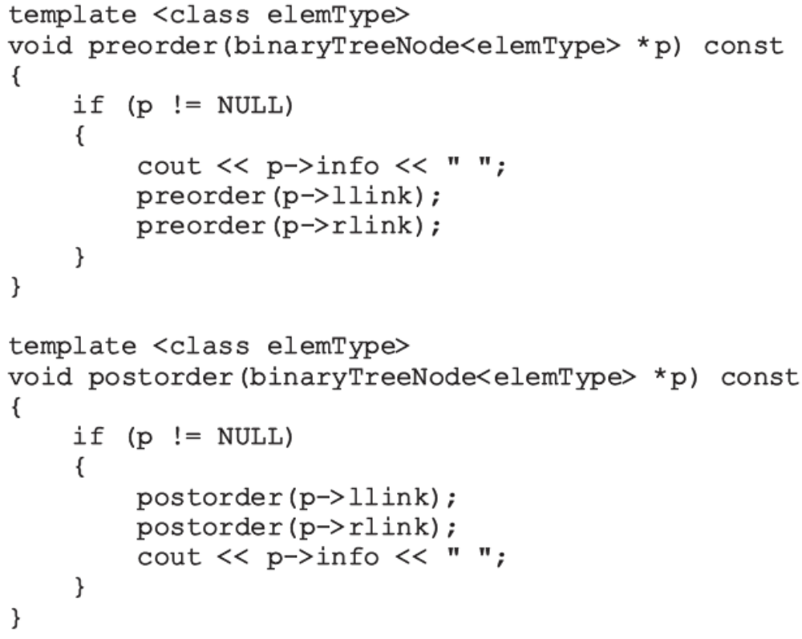
Binary Tree Traversal (cont’d.)
Functions to implement the preorder and postorder traversals
Data Structures Using C++ 2E

Slide 16
Implementing Binary Trees
Operations typically performed on a binary tree
  Determine if binary tree is empty
  Search binary tree for a particular item
  Insert an item in the binary tree
  Delete an item from the binary tree
  Find the height of the binary tree
  Find the number of nodes in the binary tree
  Find the number of leaves in the binary tree
  Traverse the binary tree
  Copy the binary tree
Data Structures Using C++ 2E

Slide 17
Implementing Binary Trees (cont’d.)
class binaryTreeType
  Specifies basic operations to implement a binary tree
  See code on page 609
    Contains statement to overload the assignment operator, copy constructor, destructor
    Contains several member functions that are private members of the class
Binary tree empty if root is NULL
  See isEmpty function on page 611
Data Structures Using C++ 2E

Slide 18
Implementing Binary Trees (cont’d.)
Default constructor
  Initializes binary tree to an empty state
  See code on page 612
Other functions for binary trees
  See code on pages 612-613
Functions: copyTree, destroy, destroyTree
  See code on page 614
Copy constructor, destructor, and overloaded assignment operator
  See code on page 615
Data Structures Using C++ 2E

Slide 19
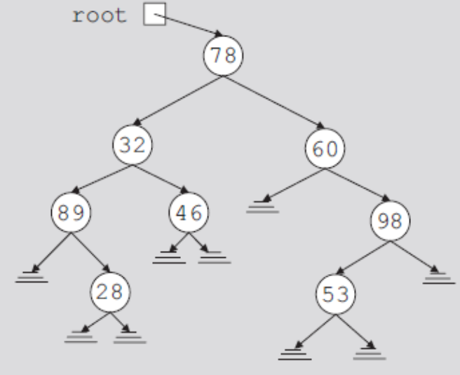
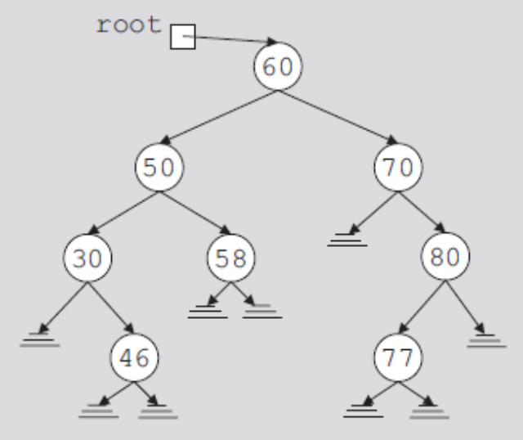
Binary Search Trees
Data in each node
  Larger than the data in its left child
  Smaller than the data in its right child
FIGURE 11-6 Arbitrary binary tree
FIGURE 11-7 Binary search tree
Data Structures Using C++ 2E

Slide 20
Binary Search Trees (cont’d.)
A binary search tree, T, is either empty or the following is true:
  T has a special node called the root node
  T has two sets of nodes, L_{T} and R_{T} , called the left subtree and right subtree of T, respectively
  The key in the root node is larger than every key in the left subtree and smaller than every key in the right subtree
  L_{T} and R_{T} are binary search trees
Data Structures Using C++ 2E

Slide 21
Binary Search Trees (cont’d.)
Operations performed on a binary search tree
  Search the binary search tree for a particular item
  Insert an item in the binary search tree
  Delete an item from the binary search tree
  Find the height of the binary search tree
  Find the number of nodes in the binary search tree
  Find the number of leaves in the binary search tree
  Traverse the binary search tree
  Copy the binary search tree
Data Structures Using C++ 2E

Slide 22
Binary Search Trees (cont’d.)
Every binary search tree is a binary tree
Height of a binary search tree
  Determined the same way as the height of a binary tree
Operations to find number of nodes, number of leaves, to do inorder, preorder, postorder traversals of a binary search tree
  Same as those for a binary tree
    Can inherit functions
Data Structures Using C++ 2E

Slide 23
Binary Search Trees (cont’d.)
class bSearchTreeType
  Illustrates basic operations to implement a binary search tree
  See code on page 618
Function search
Function insert
Function delete
Data Structures Using C++ 2E

Slide 24
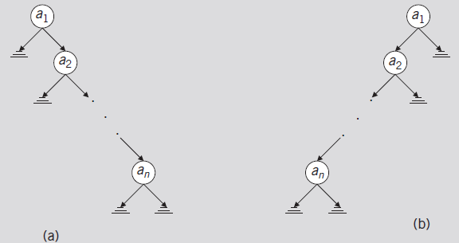
Binary Search Tree: Analysis
Worst case
  T: linear
  Successful case
    Algorithm makes (n + 1) / 2 key comparisons (average)
  Unsuccessful case: makes n comparisons
FIGURE 11-10 Linear binary trees
Data Structures Using C++ 2E

Slide 25
Binary Search Tree: Analysis (cont’d.)
Average-case behavior
  Successful case
    Search would end at a node
    n items exist, providing n! possible orderings of the keys
  Number of comparisons required to determine whether x is in T
    One more than the number of comparisons required to insert x in T
  Number of comparisons required to insert x in T
    Same as number of comparisons made in the unsuccessful search reflecting that x is not in T
Data Structures Using C++ 2E

Slide 26
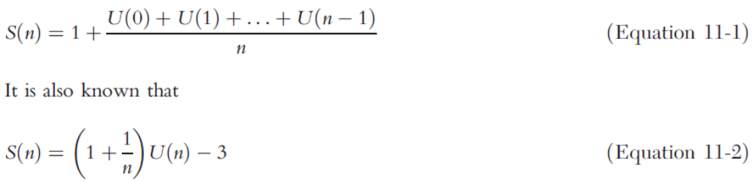
Binary Search Tree: Analysis (cont’d.)
Data Structures Using C++ 2E

Slide 27
Binary Search Tree: Analysis (cont’d.)
Theorem: let T be a binary search tree with n nodes, where n> 0
  The average number of nodes visited in a search of T is approximately 1.39log₂n =O(log₂n)
  The number of key comparisons is approximately 2.77 log₂n = O(log₂n)
Data Structures Using C++ 2E

